Slide 1
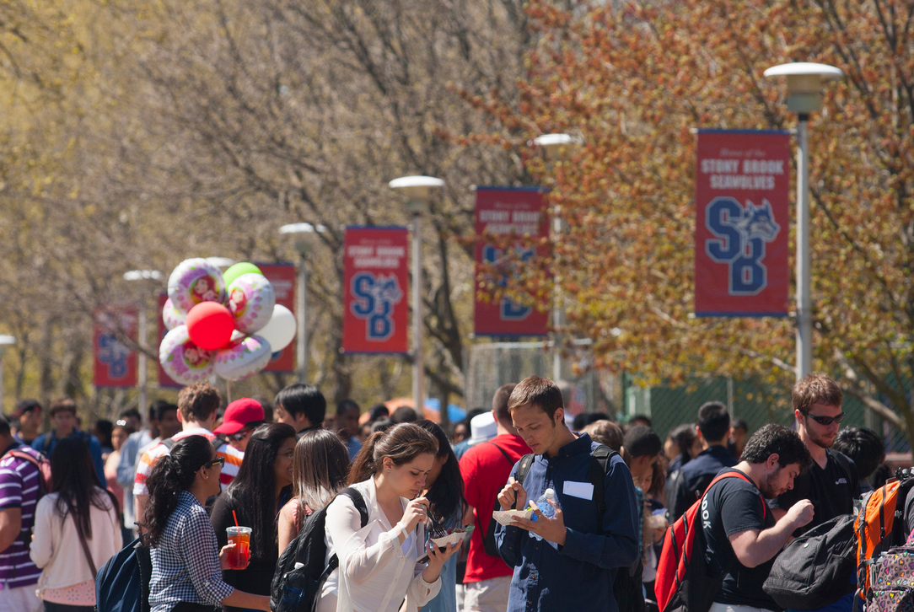


Hiring Students in SOLAR
for your department
Brought to you by
DoIT Training
Music by
Chris Zabriskie
“Air Hockey Saloon”

Slide 2
What to expect during this tutorial
Consider blocking out 30 minutes for this training
50 narrated slides
clickable links through out, like: go.stonybrook.edu/hiringstudents
4 questions at the end
Hit Enter or Next button to advance
OR
Use the Table on Contents to skip around

Slide 3
Becoming a Student Employment Coordinator
Request
The SEC’s supervisor must a submit a request to HR
Review training and help materials
Read the Student Employment handbook each year
Contains policies governing student employment
Training
Handbook

Slide 4
SEC’s Responsibilities
Create and Update Job Assignments
Appoint Students into
Assignments
Approve Timesheets
Print Rosters and Reports
Extend Assignments
Terminate Appointments

Slide 5
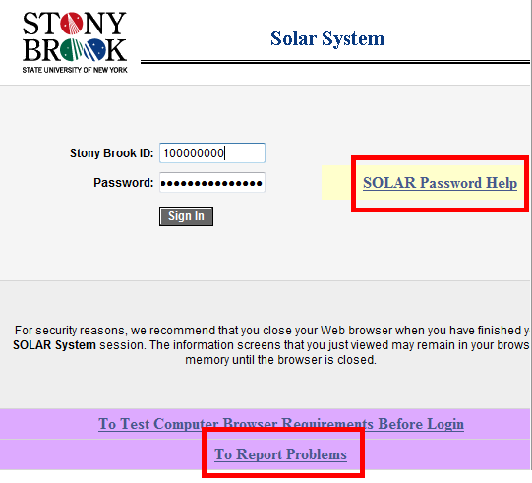
Student Employment is Accessed in SOLAR
www.stonybrook.edu/solarsystem
Log in using:
  Stony Brook ID
  SOLAR password
If you cannot log in click:
To Report Problems

Slide 6
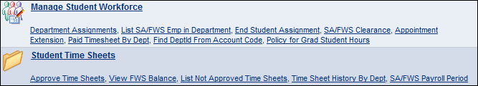
In SOLAR
...you will see 2 new sections on the home page.
  Manage Student Workforce
  Student Time Sheets

Slide 7
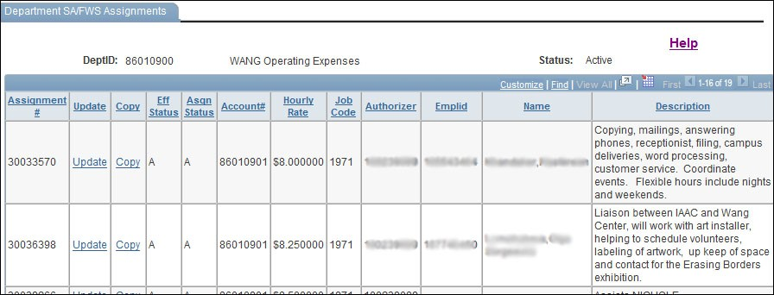
Creating a Job Assignment
Copy an EXISTING job Assignment
Update the copied assignment(s)

Slide 8
Department ID = Your main State Budget Acct.
Department ID # 88888888
This is your main State Budget acct.
Create Assignments under this.
Account code: 44444444
Some salaries may be dispersed against this acct. code.
Account code: 3333333
Some salaries may be dispersed against this acct. code.
Account code: 2222222
Some salaries may be dispersed against this acct. code.
Needed for every SEC transaction

Slide 9
Finding your Department ID
Ask your department administrator or budget coordinator
Click:
Find DeptID from Account Code

Slide 10

Job Codes when Creating an Assignment
Student Assistant (SA)= 1971
Federal Work Study (FWS) = 1721
100% of Salary comes out of your Budget Account
100% of Salary comes out of the student’s financial aid award
The system will not allow you to appoint a student into a FWS assignment without a sufficient award
* Prior to appointing the student into the assignment, you may change the
Job Code if necessary

Slide 11
Also Important: Time Sheet Authorizers
Be sure to have at least 2 time sheet authorizers
*Time sheets need to be approved in order for student to receive a paycheck.

Slide 12
Advertise Jobs on HandShake
Post Jobs on the Career Center’s HandShake
  Contact: Casey.Savin@stonybrook.edu
Students submit resumes or contact department to arrange interview
Department interviews and selects desired candidate

Slide 13
Appointing a Student into an Assignment
The system will determine if the student is CLEARED to work
Cleared?
NO
YES
See Errors
in comments
Click the link provided to Appoint the Student

Slide 14
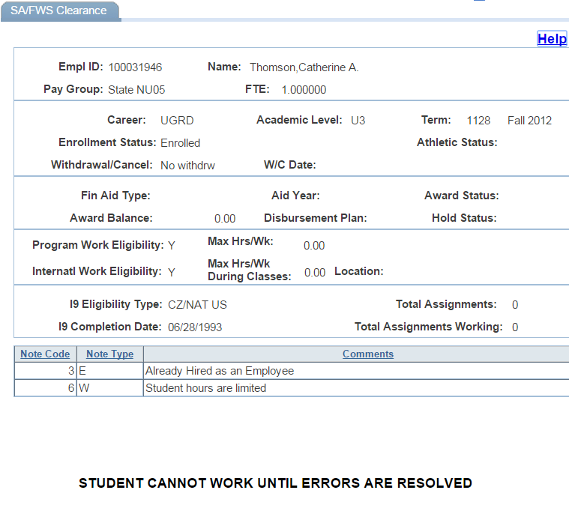
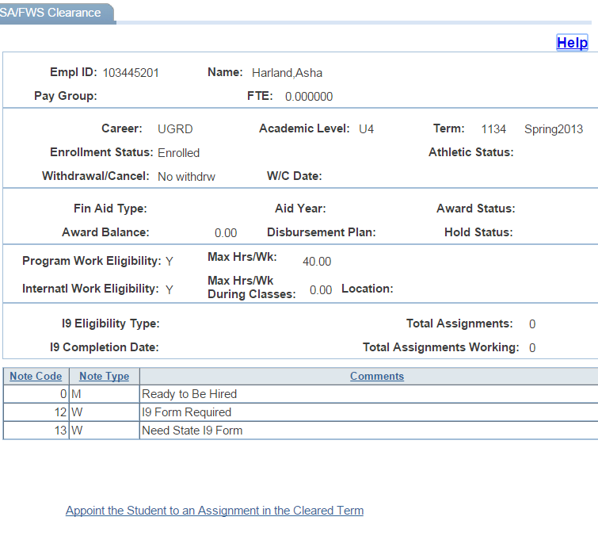
Clearing the Student

Slide 15
Students should not work until
COMPLETELY
Cleared in the System
STOP
There can be a liability or penalization to both student and SBU

Slide 16
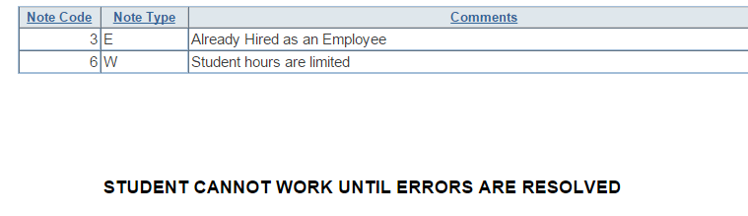
Student Clearance Comments
Messages on the SA/FWS Clearance page are
  W = Warning: student can be appointed but there are issues to be cleared up with HR
  E = Error: student cannot be appointed
  M = Message: will state "ready to be hired“
The student must reconcile his/her own clearance issues before the system will allow you to hire them.

Slide 17
Examples of Errors and Warnings
E = Errors
W = Warnings
Missing SS#
Not Authorized to work
  Call Visa and Immigration 2-4685
FWS award not accepted
Ineligible to Enroll
  Student has blocks
Withdrew from University
Non-Matriculated
I-9 Form Required
Need State I-9 Form
  *students can be appointed with warnings but must attend to these
  SEC’s may take the I-9 workshop with HRS:
  http://www.stonybrook.edu/hr/training/courses.shtml

Slide 18

I-9 Information Warnings
Forms must be submitted to State Appointments within three days of hire or the student will be terminated.
Email reminders sent out to supervisors if not received before student enters their first timesheet on SOLAR.
Authorized signatory will be notified if there are any errors on the I-9 form. All errors must be corrected before the form can be processed.
An updated I-9 form is also necessary if the employee has not been on payroll for more than one year. You will not see this on the clearance page, but you will receive an email from HR Student Employment to remind you that a new I-9 needs to be completed

Slide 19
Maximum Hours
Type of Student | Fall/Spring Term | Intersession (Winter)/Summer Term
Student Assistant | 29 | 29
International Student (Student Assistant) | 20 | 29
Federal Work Study | 40 | 40

Slide 20
The Student Work Week
Payroll schedule:
    SA/FWS Payroll Period
Student Work Week
  starts on a Thursday
  ends on a Wednesday
Time sheet approval deadline is the Friday by 5pm at the end of the pay period--
    otherwise…
    The student will not get paid

Slide 21
Time Sheets
Students fill out their time sheets
each day they work in SOLAR
SECs make corrections and then
approve timesheets

Slide 22
Checking Federal Work Study Balance
Supervisors MUST be aware of their
student’s FWS balance at all times!
  SA/FWS Clearance
  FWS Balance
  Paycheck Roster
  SEC's and students receive a message
  in SOLAR when the balance drops below $250
Students will receive an error when logging in hours that exceed this balance.
If they are going to continue to work and they have no funds left, you must terminate the current assignment and appoint them into a new Student Assistant assignment.

Slide 23
Terminating an Appointment
Terminate before End Date use End Student Assignment
Otherwise, the End Date on Fall/Spring assignments is Mid-May on a Wednesday
  Check Payroll Period schedule

Slide 24
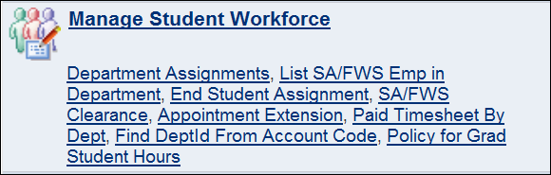
Extending an Appointment
Extend CONSECUTIVE terms only
  Spring → Summer
  Summer → Fall
The Appointment Extension must be completed before the next term:
  After May 1 for Summer
  After August 1 for Fall

Slide 25

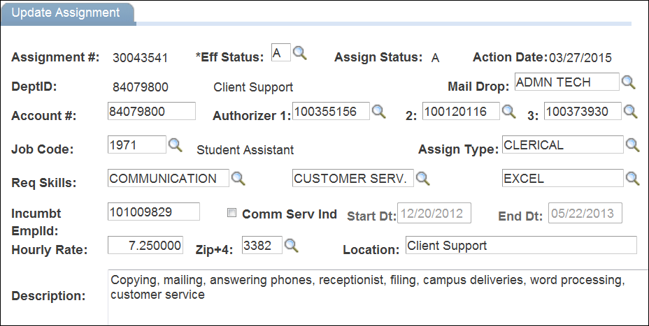
Extending an Appointment Note
**This takes 24 hours to appear in SOLAR. View the Assignment the next day

Slide 26
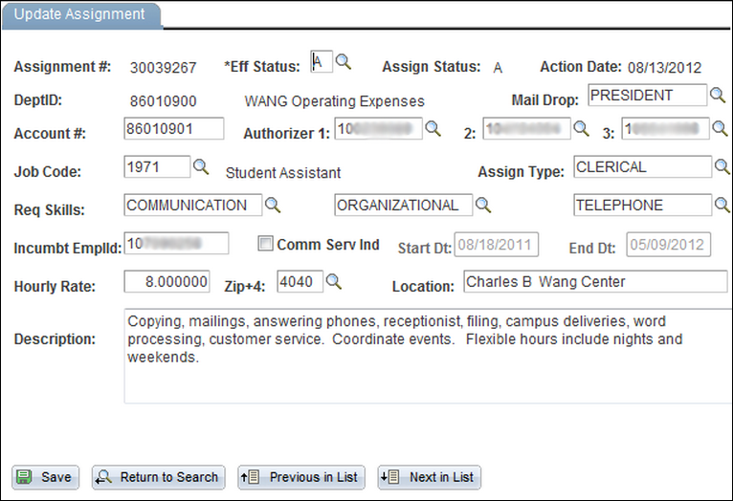
Updating Assignments
Vacant Assignments
Filled Assignments
(student are appointed into them)
Any… (not incumbt emplid)
Fields that you can edit are:
  Change Time Sheet Authorizers
  Job Skills / Description
*Contact HRS Student Payroll to change
  Hourly Rate (for raises)
  Mail Drop (where student paychecks go)

Slide 27
Sometimes you may have to..
Terminate and Create New Assignments
When the account the student is paid out of:
  A department’s account (account code that pays the student assistant’s salary)
  A student’s Federal Work Study award
is exhausted:
Terminate
The assignment
Create a New Assignment
With a new Account code / Job Code
Clear/Appoint
The student into the new assignment
* It is important to terminate the old assignment so that students do not log hours on an exhausted account/job code

Slide 28
Notes on Old Assignments in SOLAR
Will remain on your list of “active” assignments even after the End Date has passed
Will be moved automatically to the “inactive” assignment list the following Fall

Slide 29
More Reports and Rosters SEC’s Can Draw
List Student Employees in the Department
Track department student salary expenditure by viewing Paid Timesheets
Unapproved time sheets
Time sheet history
Check out: Things you need to know when
downloading reports.

Slide 30

Student Paychecks
Paychecks are picked up by an authorized signatory on payday
Make sure all students know where to pick up paychecks in your department
Have students sign the check roster that is distributed with the paychecks, and keep for your records
You can mail FWS and SA paychecks if a student does not pick it up
You may not mail TA or GA paychecks

Slide 31
Why a Student did not Receive a Paycheck
Students will be paid on the following pay period if:
  Student did not input their hours on time
  Supervisor did not approve the timesheet before the deadline (Friday 5pm)
The student works in more than one department
  The check is sent to the first department in which the student began working

Slide 32

Lost Paychecks
The student will need to fill out a Lost Paycheck Form
  www.stonybrook.edu/hr > Forms and Publications > More > Payroll
  Or go to HRS Room 390 Administration Building
Replacement takes 4 to 6 weeks
The student will be contacted when the replacement check is available to be picked up
  Student must bring photo ID
Why risk it? Sign up for Direct Deposit!

Slide 33
Help & Questions
Human Resource Services Student Payroll: 2-6094
  Can't create assignments
  Payroll problems
Contact: State Appointments: 2-6195
  I - 9 issues
www.stonybrook.edu/hr/resources/student_employee
  Information on Benefits, Direct Deposit, request access to be a Student Employment Coordinator

Slide 34
Thank you for participating in this training module
Next steps:
Click here to provide us feedback!
Email DoIT_Training@stonybrook.edu to confirm that you have finished training.
Close your browser

